Slide 1
VASANTH KUMAR. D
Final Project
3/21/2024 Annual Review

Slide 2
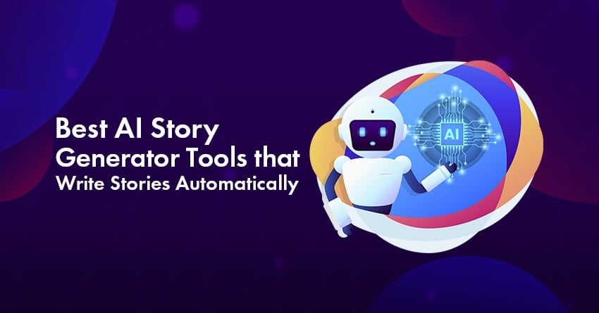
PROJECT TITLE
RNN- based story generator
consideration with text style transfer
3/21/2024 Annual Review

Slide 3


AGENDA
The RNN-Based Story Generator with Text Style Transfer project aims to create engaging narratives by employing Recurrent Neural Networks (RNNs) and style transfer techniques. Utilizing the GPT-2 model, the program generates stories based on provided prompts and style labels. Through a Python implementation, it loads the model and tokenizer, then utilizes a dedicated function to produce text, considering parameters like temperature and top-p for nuanced generation. The demonstration showcases the effectiveness of the approach, exemplified by the generated story. This project opens avenues for various applications, from personalized storytelling to content creation in marketing. Future enhancements could involve refining style transfer mechanisms and exploring broader narrative styles for increased versatility.
3/21/2024 Annual Review

Slide 4

PROBLEM STATEMENT
Traditional story generation methods often lack customization and fail to capture specific writing styles, limiting creativity and engagement. Additionally, manually generating stories can be time-consuming and labor-intensive, particularly for writers, educators, and content creators seeking fresh and diverse narratives. There is a need for an automated solution that can generate personalized stories tailored to user-specified prompts and writing styles efficiently.
3/21/2024 Annual Review

Slide 5

PROJECT OVERVIEW
The RNN-Based Story Generator with Text Style Transfer project utilizes Recurrent Neural Networks (RNNs) and style transfer techniques to craft engaging narratives. By leveraging the GPT-2 language model, users can input prompts and specify desired writing styles, resulting in dynamically generated stories. Through a Python implementation, the project demonstrates the generation process, showcasing its potential for personalized storytelling and content creation across various domains. Future enhancements may focus on refining style adaptation mechanisms and exploring additional narrative styles, promising exciting advancements in automated storytelling.
3/21/2024 Annual Review

Slide 6

WHO ARE THE END USERS?
The end users of the RNN-Based Story Generator with Text Style Transfer project encompass a broad spectrum, ranging from creative writers seeking inspiration to marketers crafting engaging content and the list is below:
Creative Writers and Authors
Content Creators and Marketers
Educators and Students
Entertainment Industry Professionals
General Public
AI Enthusiasts and Researchers
3/21/2024 Annual Review

Slide 7

YOUR SOLUTION AND ITS VALUE PROPOSITION
Solution: RNN-Based Story Generator with Text Style Transfer
Value Proposition: Enables personalized and dynamic story generation tailored to user-specified prompts and writing styles, saving time for creative writers, educators, and content creators, while also providing a practical application for AI enthusiasts and researchers to study natural language processing. Additionally, it fosters innovation in the entertainment industry and offers entertainment and inspiration to the general public.
3/21/2024 Annual Review

Slide 8

THE WOW IN YOUR SOLUTION
The wow factor in this solution lies in its ability to seamlessly merge advanced technology with creative expression. By harnessing the power of Recurrent Neural Networks (RNNs) and style transfer techniques, the RNN-Based Story Generator with Text Style Transfer offers users the unprecedented ability to create personalized narratives with just a prompt and a chosen writing style. This innovative approach not only saves time for writers, educators, and content creators but also opens up new avenues for exploration and creativity. Whether it's crafting engaging content for marketing campaigns or experimenting with different narrative techniques in the classroom, this solution empowers users to effortlessly generate captivating stories tailored to their preferences.
3/21/2024 Annual Review
8

Slide 9
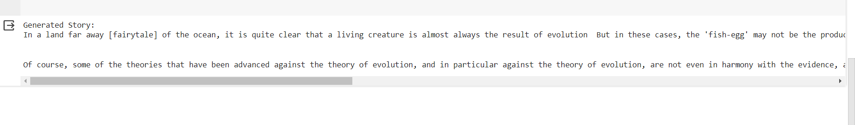
MODELLING
Teams cam add wireframes
In the modeling phase of the RNN-Based Story Generator with Text Style Transfer, a neural network architecture, such as the GPT-2 model, is crafted and fine-tuned to understand language patterns and writing styles. Through training on extensive text data, the model learns to generate coherent and contextually relevant stories based on user prompts. This process involves adjusting parameters to minimize errors and optimize performance. Additionally, the model can be fine-tuned for style transfer, ensuring that generated text aligns with specified writing styles. Overall, modeling is pivotal in creating a powerful tool capable of producing personalized and engaging narratives efficiently.
3/21/2024 Annual Review
9

Slide 10
RESULTS
The result of the RNN-Based Story Generator with Text Style Transfer is a captivating and personalized narrative that seamlessly integrates user-specified prompts and writing styles. Leveraging advanced neural network architecture, the generated stories are not only coherent and contextually relevant but also imbued with the desired tone and mood. Whether it's a whimsical fairytale or a gripping thriller, the output reflects the creativity and preferences of the user. This innovative solution saves time for writers, educators, and content creators while providing an endless source of inspiration and entertainment. Ultimately, the result is a remarkable fusion of technology and creativity, offering users a unique storytelling experience tailored to their individual preferences.
https://colab.research.google.com/drive/13OxnNTF0b-_Sl0uQqsQ8Di-6vmiL-vyI#scrollTo=Wf5KrEb6vrkR
10

